Slide 1
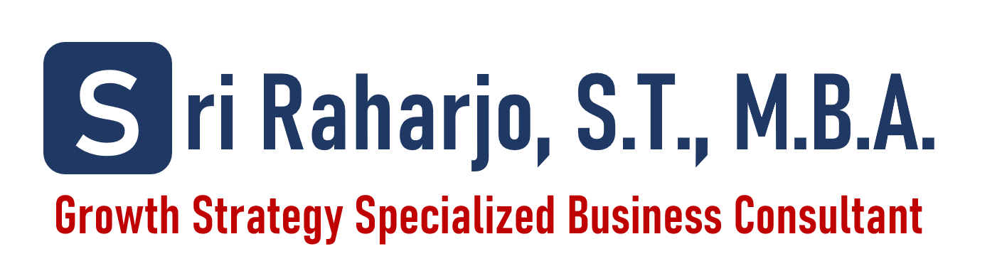
STRATEGIC MANAGEMENT
FRAMEWORK

Slide 2

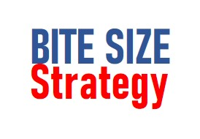
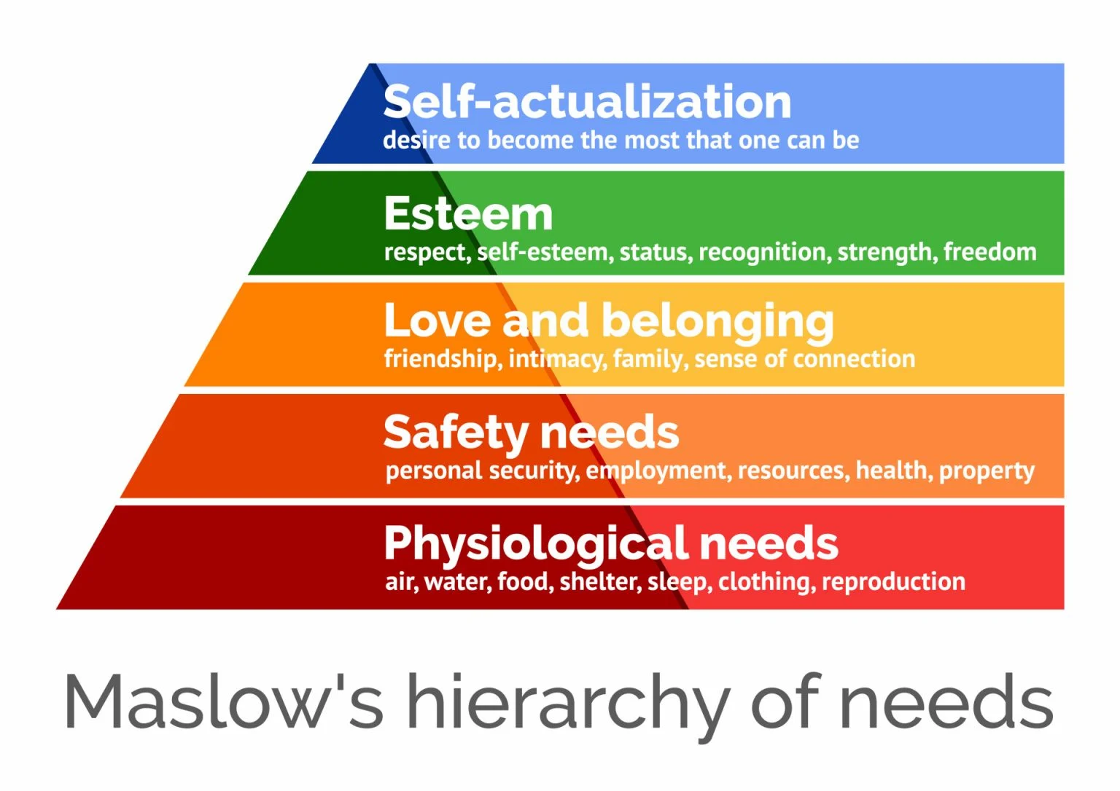


HIGH LEVEL INDUSTRY VALUE CHAIN
The Structure Of Industry Using Hierarchy Of Need Maslow
Customer Consciousness
Customer Need And Want
Horizontal Layer
Primary Layer Business
Vertical Layer
Secondary Layer Business
Tertiary Layer Business
Powered By:
VISIT!

Slide 3
HIGH LEVEL INDUSTRY VALUE CHAIN
The Structure Of Industry Using Industry Value Chain Analysis
Primary Industry Value Chain
Intermediate Goods
Finish Goods
Raw Material
Supplier
Producer
Distributor
Retailer/ Seller
Customer
Internal Company Value Chain
Internal Company Value Chain
Internal Company Value Chain
Internal Company Value Chain
Primary, Secondary, Tertiary Need
B2G, B2B, B2C
Local, National, International (Export)
Source: Internal (Domestic), External (Import)
Supporting Industry Value Chain
B2B Industry
Resource based-View Theory
Internal Company
Value Chain
Outsourcing Industry
Resource
Capability
B2B Service Industry
Have
Don’t Have
Capability
What it is look like
B2B Opportunity
What is being Outsource?
Have
Change Ownership
Resource
Don’t Have
B2B Opportunity
B2B Opportunity
Powered By:
VISIT!

Slide 4
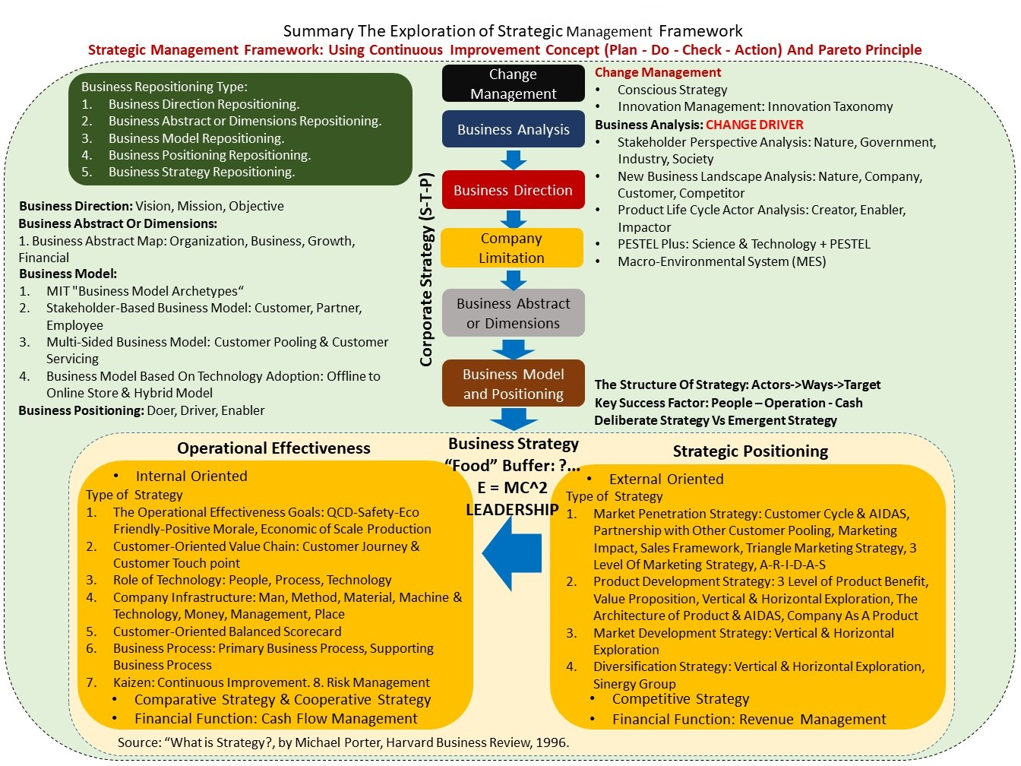
STRATEGIC BUSINESS MANAGEMENT
Powered By:
VISIT!

Slide 5
Change Management
The Structure Of Strategy
Innovation Taxonomy
VISIT!

Slide 6
I. CHANGE MANAGEMENT
THE STRUCTURE OF STRATEGY
Try To Breakdown The Structure Of Strategy In Order To Help Determine What Factor That Contribute To The Success Of Strategy
Actor
Ways
Target
Stakeholder Perspective Analysis
Motivation Theory
Agency Theory
Strategic Situation Analysis
Strategic Formulation
Strategic Implementation
Strategic Evaluation
Balanced Scorecard
KPI
OKR
Powered By:
VISIT!

Slide 7
I. CHANGE MANAGEMENT
INNOVATION TAXONOMY
Innovation Taxonomy Is The Classification Of Innovation Orientation In The Perspective Of Customer To Understand The Structure Of Innovation And The Impact
INNOVATION FOCUS
Less Segmented
Primary Need
Secondary Need
Secondary Need
More Segmented
Tertiary Need
Tertiary Need
Tertiary Need
Tertiary Need
Powered By:
VISIT!

Slide 8
Business Analysis: CHANGE DRIVER
Stakeholder Perspective Analysis: Nature, Government, Industry, Society
New Business Landscape Analysis: Nature, Company, Customer, Competitor
Product Life Cycle Actor Analysis: Creator, Enabler, Impactor
PESTEL Plus: Science & Technology + PESTEL
VISIT!

Slide 9
II. BUSINESS ANALYSIS
Comprehensive Business Analysis: Using The Combination of External Analysis And Internal Analysis
EXTERNAL ANALYSIS
CONCLUSION
INTERNAL ANALYSIS
DIRECTION AND ACTION PLAN
Resources
Business Objective
Opportunities
Key Success Factor
Business Objective
Capabilities
Business Abstract Or Dimensions
Challenges
Competency
Business Model And Positioning
Competitive
Advantage
Business Strategy
External Analysis:
Macro-Stakeholder Perspective Analysis: Nature, Government, Industry, Society
New Business Landscape Analysis: Nature, Company, Customer, Competitor
Product Life Cycle Actor Analysis: Creator, Enabler, Impactor
GAP Analysis
Powered By:
VISIT!

Slide 10
II. BUSINESS ANALYSIS
EXTERNAL ANALYSIS
Macro Environment Analysis Using Combination of PESTEL and Stakeholder Perspective Analysis
Nature Perspective
Government Perspective
(PESTEL)
External Macro Environment
Threat of New Entrants
External Micro Environment
Porter Five Forces
Supplier Power
Competitor
Rivalry
Buyer Power
Industry Perspective
(PESTEL)
Threat of Substitute
Society Perspective
(PESTEL)
Powered By:
VISIT!

Slide 11
II. EXTERNAL ANALYSIS
Exploration For Business Opportunity In The Macro Environment And The Stakeholder
Nature Perspective
New Business Opportunity Exploration In The Business To Nature Market. The Opportunity That Lies in The Nature:
“While the risks to our global economy are daunting, nature also provides ample benefit and opportunity. For example, nature provides services worth at least $125 trillion per year globally. In The Future of Nature and Business, the World Economic Forum identified 15 systemic transitions with annual business opportunities worth $10 trillion that could create 395 million jobs by 2030”
Source: https://www.businessfornature.org/businesscase
Business To Nature
Government Perspective
(PESTEL)
Business To Government
External Macro Environment
Threat of New Entrants
External Micro Environment
Porter Five Forces
Supplier Power
Competitor
Rivalry
Buyer Power
Industry Perspective
(PESTEL)
Society Perspective
(PESTEL)
Threat of Substitute
Business To Customer
Business To Business
Powered By:
VISIT!

Slide 12
II. BUSINESS ANALYSIS
NEW BUSINESS LANDSCAPE
Correlation Between Business Objective and New Business Landscape
Business Objective: Profit & Sustainable Growth
New Business Landscape: N + 3C (Kenichi Ohmae)
NATURE
COMPANY
CUSTOMER
COMPETITOR
Customer-Oriented Business Landscape
Kenichi Ohmae states that these three factors must be in balance in the form of a strategic triangle. These three key factors for success are:”
1. The Corporation
2. The Customer
3. The Competition
Source: https://www.toolshero.com/strategy/3c-model-ohmae/
Powered By:
VISIT!

Slide 13
II. BUSINESS ANALYSIS
Product Life Cycle Actor Analysis: Creator, Enabler, Impactor
External Business Analysis: Using Combination of Product Life Cycle Actor and Stakeholder Perspective Analysis
PRODUCT LIFE CYCLE
IMPACTOR
Stakeholder
POSITIVE IMPACTOR
Stakeholder
Product
Extension
SALES
ENABLER
Stakeholder
NEGATIVE IMPACTOR
Stakeholder
CREATOR
Stakeholder
Introduction
Growth
Maturity
Decline
TIME
1. Creator: A Creator is someone or something that starts an industry by bringing a new idea, product, or way of doing business. They create the foundation that makes the industry possible.
2. Enabler: An Enabler is someone or something that helps an industry work better, faster, or grow bigger. This could be through tools, technology, systems, or support that make things run more smoothly.
3. Impactor: An Impactor is a factor that strongly influences the direction or changes in an industry. It can be a trend, new rule, technology, or event that causes the industry to shift or adapt.
Powered By:
VISIT!
Notes:
Exploration on the framework of Business Analysis by combining Product Life Cycle Element and Stakeholder Perspective Analysis to enhance the clarity of analysis

Slide 14
II. BUSINESS ANALYSIS
PESTEL PLUS
Exploration on How The Development Of Science And Technology Can Drive The Change OF PESTEL
Change Driver: PESTEL Plus
Science & Technology
Politic
Economy
Social
Technology
Environment
Legal
Powered By:
VISIT!

Slide 15
Business Abstract Or Dimensions:
1. Business Abstract Map: Organization, Business, Growth, Financial
VISIT!

Slide 16
III. BUSINESS ABSTRACT OR DIMENSION
BUSINESS ABSTRACT MAP
Example Summary of Growth Strategy of OVO (Indonesia Fintech Company)
Business Abstract or Dimensions
The Corporate Strategy level concerns itself with the entirety of the organization on a more or less Abstract Level.
https://www.cascade.app/blog/corporate-strategy
Business Abstract Map OVO
Sustainable Business and Profitable
Financial
Perspective
F1
Increase Company Revenue
F2
Decrease Company Cost
F3
Increase Company Valuation
Business Abstract Map is to Help Define Corporate Strategy That Often Play In The Field Of Company Abstract That Often Confusing Because Not Having Boundary To Be Used. Consist Of Financial Perspective, Growth Perspective, Business Perspective And Organization Perspective
G1
Organic Development of Express 4.0
Increase B2B and B2C Market Penetration
Growth
Perspective
G1
Strategic Partnership with other “Customer Pooling” Company
G2
Organic Acquisition of Mobile Warehouse
G3
Strategic Partnership of Sentra E-Commerce
G3
Strategic Partnership of Financial Services
G2
Organic Product Development
Widening Core Business from Payment into Financial Services
Business
Perspective
B1
E-Payment Business Development
B2
Accelerate Financing Business
B3
Accelerate Investment Business
B4
Accelerate Insurance Business
Develop New Competitive Advantage
Organization Perspective
O1
Improve Sustainable Culture
O2
Improve Information Technology
Source: https://katadata.co.id/berita/2019/12/03/fokus-pada-tiga-layanan-ovo-kurangi-bakar-uang-tahun-depan
Powered By:
VISIT!
Notes:
https://katadata.co.id/berita/2019/12/03/fokus-pada-tiga-layanan-ovo-kurangi-bakar-uang-tahun-depan
Exploration on the summary possibility of OVO (Indonesia Fintech Industry) Long-Term Strategy, based on their press release...

Slide 17
III. BUSINESS ABSTRACT OR DIMENSION
BUSINESS ABSTRACT MAP
Example Summary of Growth Strategy of Telkom Group (Indonesia Telecommunication Company)
GROWTH STRATEGY MAP TELKOM GROUP
Sustainable Business and Profitable
Financial
Perspective
F1
Increase Company Revenue
F2
Decrease Company Cost
F3
Increase Company Valuation
Consideration:
Maximizing opportunities
Increasing competitiveness
Value creation
Strategy:
Increase market Penetration
Cost Leadership And Increase Operating Advantage By Sinergy Group
G1
Organic Development of Express 4.0
Increase B2B and B2C Market Penetration
Growth
Perspective
G1
Focus Market Penetration By Separate B2B And B2C Market
G2
Organic Acquisition of Mobile Warehouse
G3
Strategic Partnership of Sentra E-Commerce
G2
Sinergy Group To Create Competitive Advantage
G3
Strategic Partnership With Big Customer Pooling
Focus Business And Sinergy Group Named Five Bold Moves
Business
Perspective
B1
Fixed Mobile Convergence Initiative
B2
Infra Cooperative
B3
Data Center Cooperative
B4
B2B Digital IT Service Cooperative
B4
Digital Cooperative
Develop New Competitive Advantage
Organization Perspective
O1
Improve Sustainable Culture
O2
Improve Information Technology
Powered By:
VISIT!
Notes:
https://katadata.co.id/berita/2019/12/03/fokus-pada-tiga-layanan-ovo-kurangi-bakar-uang-tahun-depan
Exploration on the summary possibility of OVO (Indonesia Fintech Industry) Long-Term Strategy, based on their press release...

Slide 18
Business Model:
MIT "Business Model Archetypes“
Stakeholder-Based Business Model: Customer, Partner, Employee
Multi-Sided Business Model: Customer Pooling & Customer Servicing
Business Model Based On Technology Adoption: Offline to Online Store & Hybrid Model
VISIT!

Slide 19
III. BUSINESS MODEL
STAKEHOLDER-BASED BUSINESS MODEL
In Designing A Business Model, One Must Start From Determining Stakeholder In Company That Consist Of Main Stakeholder And Supporting Stakeholder So That Company Able To Deliver Value Harmoniously. The “Weakness” Of Current Business Model Canvas Is Only Focus On Two Stakeholder That Is Customer And Partners Without Considering The Employee
Supply side
Demand side
Partner
Value Proposition
COMPANY
Value Proposition
Customer
Explore
Partner
Journey
Explore
Customer
Journey
How to Deliver
How to Deliver
Output: Supply Generation
Output: Demand Generation
How to Deliver
Value Proposition
Cost Structure
Revenue Stream
Employee
Explore Employee Journey
Powered By:
VISIT!

Slide 20






III. BUSINESS MODEL
MULTI-SIDED BUSINESS MODEL
The Example Of Implementation For Multi-sided Business Model In Digital Industry
Business Model
Depend on Customer Orientation Purposes
Customer Pooling
Customer Servicing
Combination
Become Multisided-Business Model
The Key of using Multi-Sided Business Model is to create as much as possible Related Business Development by utilizing the potential of Customer Pooling
The Apps
Customer Pooling | Search Engine, Gmail, Android, Google Play, Google Maps | Go-Ride | Online Store (Start from Online Book Store) | Online Hotel Reservation | Online Human Connection | Online Video Sharing
Customer Servicing | Google Ads, Premium | Go Car, Go Send, Go Food, Go Mart, Go Pay | Cloud computing, Online advertising, Digital streaming | Flight Ticket Reservation, Train and Bus Reservations, Car rental | Facebook Ads, Meta Business Suite | Advertising Revenue, YouTube Premium
Powered By:
VISIT!
Notes:
Exploration on the implementation of Multi-sided Business Model in various Application and how to optimize it...

Slide 21






III. BUSINESS MODEL
MULTI-SIDED BUSINESS MODEL
The Example Of Implementation For Multi-sided Business Model In General Industry
Business Model
Depend on Customer Orientation Purposes
Customer Pooling
Customer Servicing
Combination
Become Multisided-Business Model
The Implementation Of Multi-Sided Business Model In Various Industry To Understand That It Can Be Implemented Everywhere
Company
Customer Pooling | Free Television Broadcasts | Free Toys, Free Wifi | Playground, Food Court, Movie Theater | Playground, Food Court, Movie Theater | Cozy Place, Free Wifi | Cheap Ice Cream And Drink
Customer Servicing | Advertising | Food And Drink | Daily Need Goods | Daily Need Goods | Food And Drink | Food And Drink
Powered By:
VISIT!
Notes:
Exploration on the implementation of Multi-sided Business Model in various Application and how to optimize it...

Slide 22
Business Strategy:
Strategic Positioning
Operational Effectiveness
VISIT!

Slide 23
IV. STRATEGIC POSITIONING
GROWTH STRATEGY – ANSOFF MATRIX
Comprehensive Growth Strategy Framework Using Ansoff Matrix Framework To Help Solve The Challenge in Growing The Business
How To Build Product/Service
How To Build Market
Product Development Strategy
Market Development Strategy
How To Penetrate The Market
Market Penetration Strategy
How To Build New Business
Diversification Strategy
Powered By:
VISIT!

Slide 24
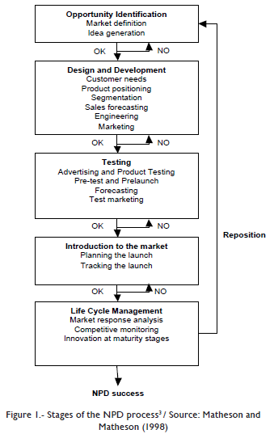
PRODUCT DEVELOPMENT STRATEGY
Exploration on Product Development Framework
Stage of the New Product Development Process
Powered By:
VISIT!

Slide 25
IV. STRATEGIC POSITIONING
PRODUCT DEVELOPMENT STRATEGY
Exploration on Product Development Framework
Segmentation
1. Opportunity Identification
The Type of Product Development Exploration:
Vertical Product Development Exploration: Vertical Level Exploration
Horizontal Product Development Exploration: Customer Journey Exploration
PRODUCT BRAINSTORMING PROCESS
Targeting
WHO→WHAT→WHY→HOW→WHEN
The Architecture of Product:
Using “Hierarchy of Effect” Product (AIDAS)
2. Design & Development
SATISFACTION
Positioning
Differentiation
Value Proposition
The Optimum Level of Product Usability
ACTION
The Easiness of Buy, Bring and Use
Visualize in 3 Level of Product Benefit
INTEREST → DESIRE
The Design of Product Attributes
Value Added Benefit
Differentiation
ATTENTION
Stimulation through The Five Senses
Actual Benefit
Positioning
Source: https://www.interaction-design.org/literature/topics/usability
Core Benefit
3. Testing
A. Prototyping
B. Success Definition
C. Piloting
3 Level of Product Benefit
Value Proposition that can be obtained by Customer
4. Introduction To The Market
5. Product Life Cycle Management

Slide 26
IV. STRATEGIC POSITIONING
MARKET PENETRATION STRATEGY
Customer Cycle & Hierarchy of Effects Model (AIDAS)
Customer-Oriented Value Chain: Customer Journey and Customer Touch Point
Customer
Target Market
Attract
Convert
Delight
Stranger
Leads
Customer
Promoter
Reasoning
Attention
Action
Satisfaction
1. Stimulation through The Five Senses
1. Sales and Personnel Readiness
2. Product, Price, Place, Channel Readiness
1. Customer Experience
Segmentation
Choose the Fastest Effect of Conversion
Targeting
Conversion
Researching
Interest
Positioning
4P: Product, Price, Promotion, Place.
Questioning: Who, What, Why, How.
Desire
1. Through Content
Marketing
Sales
Service
Market Research
Brand Activation
Sales Activation
Service Activation
Powered By:
VISIT!

Slide 27
IV. STRATEGIC POSITIONING
MARKET PENETRATION STRATEGY
The Front Model
The Component of Strategy
How To Deliver To Market
Customer Relationships
MARKETING
PRODUCT
SALES
TARGET MARKET
Channels
SERVICE
Powered By:
VISIT!
Notes:
Sudah Update

Slide 28
IV. STRATEGIC POSITIONING
MARKET PENETRATION STRATEGY
The BMS Model
More Differentiated
Long-Term Impact
Branding
Awareness
Marketing
Demand
Selling
Sales
Less Differentiated
Short-Term Impact
Powered By:
VISIT!
Notes:
Sudah Update

Slide 29
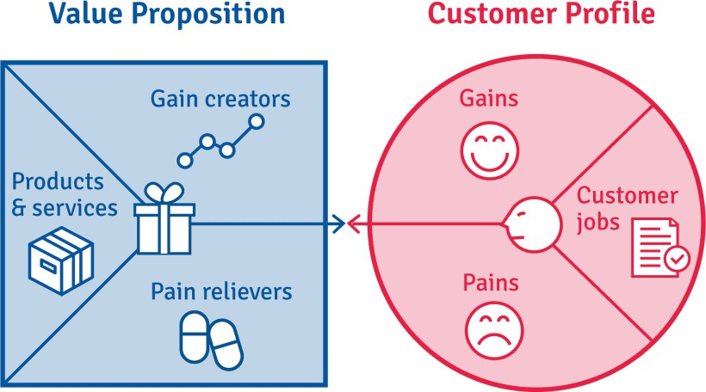
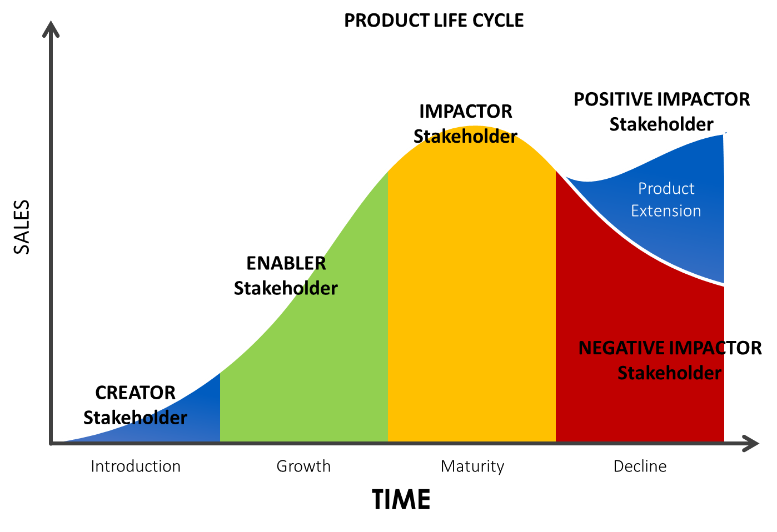
IV. STRATEGIC POSITIONING
MARKET PENETRATION STRATEGY
Product Offering And The Ecosystem
Use Value Proposition Canvas To Determine The Suitable Offering And Use Product Life Cycle Actor Role To Determine The Determinant factor of successful selling
+
Powered By:
VISIT!
Notes:
Sudah Update

Slide 30
IV. STRATEGIC POSITIONING
SALES FRAMEWORK
Comprehensive Sales Framework To Help Solve The Challenge in Sales Process
Product/Service
Value Proposition That Can Be Obtained By Customer
How To Offer The Products
Obstacles / Barriers From Customers To Purchase
Solution From The Sales Team To Solve The Obstacles
What Are The Superiority Of The Products/Services Made?
What Are The Value / Benefits That Can Be Obtained By Customers From The Superiority Of Products / Services Made?
Visualize in 3 Level of Product Benefit
Value Added Benefit
Differentiation
Actual Benefit
Positioning
Core Benefit
3 Level of Product Benefit
Value Proposition that can be obtained by Customer
Powered By:
VISIT!

Slide 31
IV. STRATEGIC POSITIONING
“COMPANY AS A PRODUCT” STRATEGY
Company As A Product Means That All Infrastructure In The Company Can Be Utilize To Support And Increase Company Profit Through Direct And Indirect Impact
Company Value Proposition Creation
How to Deliver To The Market
Company Value Chain
Primary Activity
Supporting Activity
Company Infrastructure
Man
Method
Material
Machine & Technology
Money
Management
Place
Product Development Strategy
Market Penetration Strategy
Marketing
Sales
Service
Target Market
Customer Relationships
Channels
Powered By:
VISIT!

Slide 32
IV. STRATEGIC POSITIONING
TYPES OF PRODUCTS SUMMARY
Summary of Product Types seen from an Internal Perspective and an External Perspective
Internal Perspective
External Perspective
1. Main Product
2. Complementary
product
1. Convenience Products
2. Shopping Products
3. Specialty Products
4. Unsought Products
5. Services
Product As A Products
Consumer
Products
1. Capital Goods
2. Raw Materials
3. Component Parts
4. Major Equipment
5. Accessory Equipment
6. Operating Supplies
7. Services
Types Of Products
Industrial Products
1. Company Value Chain’s Product
2. Company Infrastructure’s Product (Man, Method, Material, Machine & Tech, Money, Management, Place)
Company As A Products
1. Music And Audio
2. Video
3. Photo
4. Digital Graphics or Painting
5. Font
6. Software/Application
7. Online Course
8. Professional Services
9. E-Book
Digital Product
Powered By:
VISIT!

Slide 33
IV. STRATEGIC POSITIONING
MARKETING STRATEGY
“HIERARCHY OF EFFECT” IMPACT
STRATEGY
TARGET
IMPACT
ATTENTION
COGNITIVE
REMEMBERANCE
INTEREST
DESIRE
AFFECTIVE
EMOTIONAL ATTACHMENT
ACTION
CONATIVE
SATISFACTION
Powered By:
VISIT!

Slide 34
IV. STRATEGIC POSITIONING
PRODUCT - MARKETING ALIGNMENT IMPACT
Marketing is a "tool" to amplify or convey the "reason" why someone has to buy our product. So agree that marketing is a "war" of perception. But good marketing is one that creates the perception or reason from the product itself. Because that is what will create "trust" and lead to sustainable purchases. Not only first time buyers but repeat buyers so that business sustainability is created…
ALIGMENT OF REASON, PERCEPTION, IMAGE TO BE DELIVERED TO THE TARGET MARKET CAN CREATE TRUST LEAD TO REPEAT BUYERS AND SUSTAINABLE BUSINESS
PRODUCT
& SERVICE
MARKETING
& SALES
TARGET MARKET
Alignment
How To Deliver
What Is Being Sold
Media To Deliver To The Market
The User
Powered By:
VISIT!

Slide 35
IV. STRATEGIC POSITIONING
PRODUCT QUALITY AND CUSTOMER TRUST CORRELATION
Product Quality
 | Low | High
Low | ❌ Brand Crisis - Customers don’t trust the brand and the product is poor. - Sales decline sharply, reputation damaged. - Requires total product and branding recovery. | ⚠️ Underutilized Potential - Product quality is good, but trust is lacking. - Need proof-based marketing (testimonials, warranties, certifications).
High | ⚠️ Expectation Gap - Customers trust the brand, but product performance disappoints. - High risk of trust backlash (from love → disappointment). - Focus on quality improvement and consistency. | ✅ Competitive Advantage - High-quality product with strong customer trust. - High loyalty, positive word of mouth, and pricing power.
Customer Trust
Powered By:
VISIT!
Notes:
Sudah Update

Slide 36
IV. STRATEGIC POSITIONING
TRIANGLE MARKETING STRATEGY
Exploration On The Framework Of Triangle Marketing Strategy Structure To Help Understanding Marketing Strategy Better. Combination Of Offline And Online Channel
Marketing Campaign
Promotion Program
Picture
Testimony
Article, Video
Gamification
Plan-Do-Check Action
1. Lead Generation
A. Online Channels Program
B. Offline Channels Program
2. Lead Capture
Online Channel
Facebook
Twitter
Instagram
Youtube
Tiktok
Email
SMS
What Apps
E-Commerce
Lead Indicator:
Reach
Impression
Engagement
Conversion
Lag Indicator:
Brand Awareness
Sales
Sales Website
Whats App Chat
Google Form
Offline channel
Television
Radio
Billboard
Flyer
Poster
Event
Community
Redirect Link
Traffic Analytic
Lead Capture Program
Lead Database
Lead Follow Up
Close Win
Become Promotor
Follow Up By SALES Team
Close Lost
3. Lead Nurture
Others Lead Source (Manual)
Lead Nurturing Program
Evaluate and Nurture
Powered By:
VISIT!
Notes:
Sudah Update

Slide 37
Business Strategy:
Strategic Positioning
Operational Effectiveness
VISIT!

Slide 38
V. OPERATIONAL EFFECTIVENESS
OPERATIONAL EFFECTIVENESS GOALS
Exploration on The Company’s Operational Effectiveness Goals
The Operational Effectiveness Goals
MORALE
ECO-FRIENDLY
SAFETY
QUALITY
COST
DELIVERY
Source: https://www.creativesafetysupply.com/articles/what-is-qcdsm/
Powered By:
VISIT!

Slide 39

V. OPERATIONAL EFFECTIVENESS
THE ROLE OF TECHNOLOGY IN COMPANY
Exploration On The Possibility of Chat GPT Benefit For Company Value Chain In Order To Create More Value Added For The Company
Substitute
Company Value Chain: Customer Oriented-Value Chain→ Quality, Cost, Delivery
Process
People
Company Value Chain
Process Optimization & Efficiency
People Competency and Productivity Enhancement
Type Technology: Connectivity, Device, Application, Robot, Autonomous Machine, IoT, Artificial Intelligence
Type Technology: Connectivity, Device, Application
Complementary
Powered By:
VISIT!

Slide 40
V. OPERATIONAL EFFECTIVENESS
Customer Oriented Value Chain
Exploration On How To Create Customer Oriented Value Chain That Can Be Used When Designing Customer Oriented Balance Scorecard
Company Value Chain
Plan – Do – Check - Action
Customer-Oriented Value Chain: Customer Journey and Customer Touch Point
Primary Activities
OPERATIONAL
MARKETING & SALES
SERVICE
PROFIT & GROWTH
HUMAN RESOURCE MANAGEMENT
TECHNOLOGY
Support Activities
INFRASTRUCTURE
PROCUREMENT
FINANCE & ACCOUNTING
Exploration on How To Turn Generic Value Chain Into Customer Oriented Value Chain
Determine The Correlation Of The Stakeholder In The Company: Company, Partner, Customer
Customer Internal
Customer External
Customer Oriented Value Chain
Then Align The Value Proposition For Each Stakeholder
VISIT!
Powered By:
Notes:
Exploration on the implementation of Multi-sided Business Model in various Application and how to optimize it...

Slide 41
Business Repositioning:
Business Direction Repositioning.
Business Abstract or Dimensions Repositioning.
Business Model Repositioning.
Business Positioning Repositioning.
Business Strategy Repositioning.
VISIT!

Slide 42
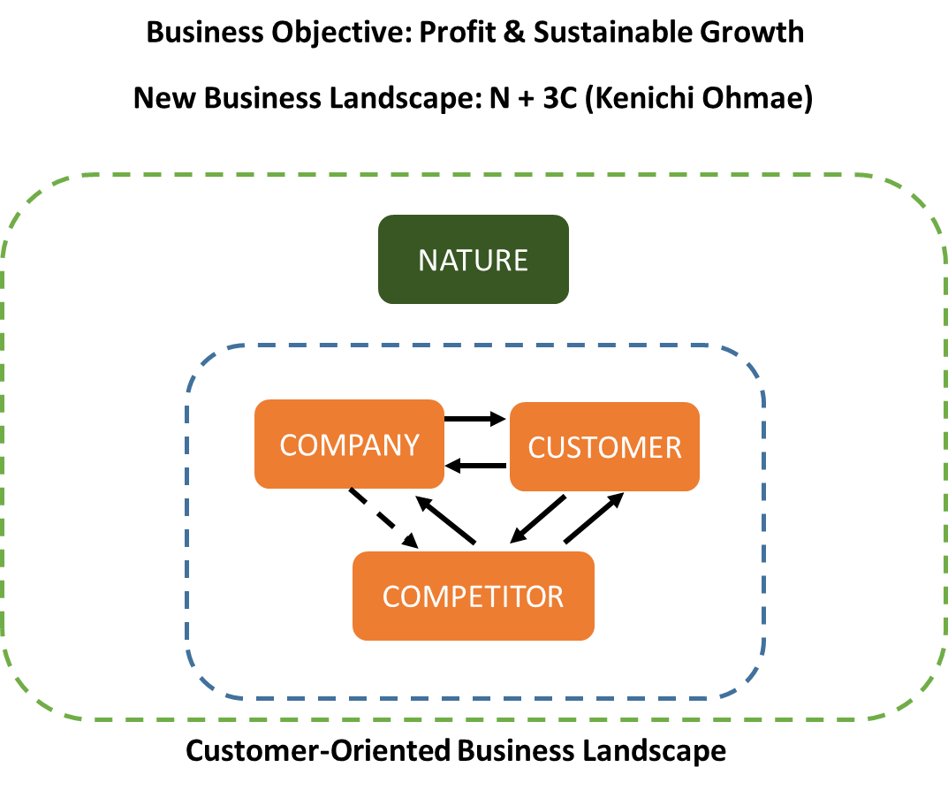
VI. BUSINESS REPOSITIONING
Exploration on Business Repositioning for Hotel Industry, in order to Repositioning their Business in regard of Covid-Disaster
1. Background for Hotel Industry
Impact to Business Landscape
Product Life Cycle Actor: Impactor
Old Business
New Business
Hotel Industry
Covid Disaster
Repositioning
Related-Vertical Product Development from Existing Business
Old Business:
For Business Transit
For Vacation Transit
For Traveling Transit
2. Related-Vertical Product Development from Existing Business-Hotel Industry
A. Full Service
B. Partial Service
Staycation: Vacation in Hotel, Family Games Console & Movie Theater in Room, Culinary Tour in Room (Delivery Service), VR-Tourist Destination Tour in Room, Sport Facility, Great View Outdoor Facility
Pregnant Mother and Early Birth – Home Care Service
Old Parent/Elderly - Home Care Service
Children Day Care Service
Autism-Children Day Care Service
Sick Recovery Person – Home Care Service
Catering, Food, Raw Material Food - Delivery Service
Laundry - Delivery Service
Snack & Drink – Delivery Service
Swimming Pool & Gym Service
Clean House - Delivery Service
House Reparation – Delivery Service
Inside and Outside Wedding Organizer & Decoration
Cooking Courses - Online
Manner Courses - Online
Make-Up Courses – Online
Babysitter Provider Service
Maid Provider Service
Powered By:
VISIT!
Notes:
My exploration on example of E-Commerce ecosystem Partnership in order to have mutual business benefit...

Slide 43
VI. BUSINESS REPOSITIONING
Exploration on Business Repositioning for Flight Industry, in order to Improve their Business in regard of Covid-Disaster
1. Background for Flight Industry
Impact to Business Landscape
Product Life Cycle Actor: Impactor
New Business Repositioning
Old Business
Flight Industry
Covid Disaster
Repositioning
Type of Business Repositioning:
Business Model Repositioning
Business Position Repositioning
Business Strategy Repositioning
Old Business:
Government: To Support Government Program
Business: For Business Travel
Society: For Vacation Travel
2. Business Repositioning
A. Business Model Repositioning: Change from Conventional Single Business Model into Multi-Sided Business Model.
Explore the Possibility of Many Related World-Wide Customer Pooling and Customer Servicing
Example:
Exclusive Application: Flight Planner, Life Planner, Educational Planner, Business Planner, Event Planner, Tourism Planner, Gamification.
Exclusive Youtube Channel: Content Creator, Educational Content, Promotional Content, Recreational Content, Business Content, Tourism Content.
B. Business Position Repositioning: Widening Business Value Proposition from “Doer” to “Enabler”.
Widening Value Proposition from Give Basic Service into Enhancement of Customer Life (Primer, Secondary and Tertiary Need)
VISIT!
C. Business Strategy Repositioning: Explore New Business Strategy from Strategic Positioning Strategy and Operational Effectiveness Strategy.
Notes:
My exploration on example of E-Commerce ecosystem Partnership in order to have mutual business benefit...

Slide 44
Financial Statement:
Financial Analogy
VISIT!

Slide 45
VII. FINANCIAL STATEMENT
Analogi Laporan Keuangan = Sebuah Mobil Bisnis
Powered By:
VISIT!
Notes:
My exploration on example of E-Commerce ecosystem Partnership in order to have mutual business benefit...

Slide 46
VII. FINANCIAL STATEMENT
Hubungan Antar Indikator Dalam Laporan Arus Kas (Cash Flow Statement). Gambaran Makro
Efisiensi Operasional (CCC ↓, Turnover ↑)
↓
Kenaikan Cashflow Operasi (OCF ↑)
↓
Free Cashflow Meningkat (FCF ↑)
↓
Likuiditas & Ketahanan Keuangan Membaik
(Current Ratio, CROA ↑)
↓
Kapasitas Investasi & Pembayaran Utang Meningkat
Powered By:
VISIT!
Notes:
My exploration on example of E-Commerce ecosystem Partnership in order to have mutual business benefit...

Slide 47
Investment:
The Investment Industry
VISIT!

Slide 48
VIII. INVESTMENT
STRUCTURAL OVERVIEW OF THE INVESTMENT INDUSTRY
Abbreviation | Full Form | Role in the Fund Structure
LP | Limited Partner | Capital provider — invests money into the fund but does not participate in management
GP | General Partner | Fund manager — executes the investment strategy, selects targets, and oversees fund operations
Investment Fund By LP: Institutional Investors / Family Offices / Government / Pension Funds / Others
Managed By GP: Investment Manager
Investment Portfolio: Investment Assets (Stocks, Private Equity, Startups, Real Estate, Credit, Others)
Return & Dividend To LP
Powered By:
VISIT!
Notes:
My exploration on example of E-Commerce ecosystem Partnership in order to have mutual business benefit...

Slide 49
Start Your Business:
The Product-Market Fit Structure
VISIT!

Slide 50
IX. START YOUR BUSINESS
The Product-Market Fit Structure
PRODUCT EXPLORATION
The Type of Product Exploration: Product Definition and Possibility
Vertical Product Exploration: Vertical Level Exploration
Horizontal Product Exploration: Customer Journey Exploration
MARKET FEASIBILITY
Market Feasibility
Market Size
Competitor
Customer
PRODUCT FEASIBILITY
Product Feasibility
Financial Analysis of The Product
Powered By:
VISIT!
Notes:
My exploration on example of E-Commerce ecosystem Partnership in order to have mutual business benefit...

Slide 51
Business Case
VISIT!

Slide 52
X. BUSINESS CASE
RUANG GURU
Example of Product Development and Market Development Exploration
1. Product Development Exploration
Ruang Guru
Indonesia-Online Tutoring Education
Application
Horizontal Product Development (Customer Journey), Suitable for B2C, B2G
Vertical Product Development
Platform
Horizontal Product Development (Customer Journey), Suitable for B2B
2. Market Development Exploration: Domestic Market & International Market, B2C, B2B, B2G
1. Children Education for Working Preparation Cycle
Primary School
Junior High School
Senior High School
Pre-Work Training
Career & Job Development
Post-Work Training
Vocational High School
Entrepreneur
Development
2. Parent Education for Family And Children Development
Child Care & Education Management
Financial management
Basic Needs
Tertiary Needs
Self Care Management
Social Management and Personal Development
VISIT!
Powered By:

Slide 53
X. BUSINESS CASE
Example of Exploration on Product Development for Food Industry, such as Agro-Industry, Livestock-Industry, Fishery-Industry and their Correlation with the Benefit for Government, Industry, Society and Nature
Vertical Product Development for Food Industry
Raw material
Market: B2G, B2B, B2C. Domestic, International
1. Increase Number of Employment (Gov)
2. Increase Product’s Value Added (Industry)
3. Increase Food Sustainability (Society)
4. Increase Environment Sustainability (Nature)
Intermediate Goods
Market: B2G, B2B, B2C. Domestic, International
Finish Goods
Market: B2G, B2B, B2C. Domestic, International
Horizontal Product Development Categorization for Finish Good in Food Industry
Finish Good
Food Product
Level 1
1. Primary Food
2. Secondary Food
3. Tertiary Food
Level 2
1. Ready To Eat
2. Have To Cooked
Level 3
1. Dry
2. Wet
3. Frozen
Level 4
1. Powder
2. Solid
3. Liquid
Level 5
1. Flavored
2. Not Flavored
Level 6
Explore the Type of Food Product as much As Possible
Powered By:
VISIT!
Notes:
My exploration on example of E-Commerce ecosystem Partnership in order to have mutual business benefit...

Slide 54
X. BUSINESS CASE
Business Possibility for Broker Application
Core Business: Transportation Broker Application
Core Competence: Delivering/Connecting
Core Customer Pooling: Go-Ride
Core Resource: Gojek Agent
Core Customer Journey Go-Ride | Ordering | Waiting | Delivering | Paying | Ending/Continue other transportation
Type Possibility | Related/Unrelated Organic/Anorganic | Doing something/Not Doing something Organic/Anorganic | Human/Things Organic/Anorganic | Cash/E-money Related/Unrelated Payment/Financing/Saving/ Investing Organic/Anorganic | Organic/Anorganic
Product Development | Related: Ordering Go-jek group Unrelated: Go-Tix (Event,Movie), Go-Travel, Go Hotel, Go-flight, Go-Train, Go-Restaurant/Cafe | Music Video Games Chat Reading | Organic: Go-ride, Go-car, Go-food, Go-send, Go-Shop, Go-Mart,Go-Box, Go Massage, Go Clean, Go-Glam, Go-Auto, Go Med An-organic: Go Bluebird | Related/Payment: Go-Pay Unrelated/payment:Go Pulsa, Go-Bill, Go-Tax Related/Financing: Microfinance for Gojek User Unrelated/Financing: Microfinancing for non Gojek user Related/Saving: Micro Saving for Gojek User Unrelated/Saving: Micro Saving for non Gojek user | Anorganic: Go-busway, Go-Flight, Go-Train, Go-Mikrolet, Go-Angkot, Go-Bajaj
Market Development | Person, Company Gojek User, Non Gojek User For Go-ride Puspose only, For All Purpose | Person, Company Gojek User, Non Gojek User For Go-ride Puspose only, For All Purpose | Person, Company Gojek User, Non Gojek User For Go-ride Puspose only, For All Purpose | Person, Company Gojek User, Non Gojek User For Go-ride Puspose only, For All Purpose | Person, Company Gojek User, Non Gojek User For Go-ride Puspose only, For All Purpose
Powered By:
VISIT!
Notes:
Inspired by Ansoff Matrix, I make an example of discovering Related-Business Possibility, i use Go-jek type of business. It can be perfected by added revenue Stream and cost structure...

Slide 55
X. BUSINESS CASE
Telecom Industry
Type of Customer: B2C
Core Business: Connectivity
Strategic Direction: Focus on Connectivity
Connectivity Infrastructure
Connectivity Media
User
Type of Connectivity:
Human-Human
Human-Machine
Machine-Machine
Type of Media:
Device
OS/Platform
Application
Type of user:
Human
Machine
Things to be Bought:
Voice
Text
Data
Type of Things to be connected:
Voice
Text
Data
Type of Buying:
One Time
Subscribe
Telecom Company Growth goal
Increase User
Voice
Sales & Marketing Strategy
Better Margin
Text
Operational Strategy
Fast Buying Turn Over
Data
Supporting from Related Ecosystem
Powered By:
VISIT!
Notes:
Inspired by Indosat Strategy that choose to focus on their core business again, here is my exploration on the Telecom industry...

Slide 56
X. BUSINESS CASE
MRT Jakarta
High Level Business Exploration
To gain more Passenger: Shift Business Focus
Commute Vehicle
Life Experience Enabler
Traffic Enabler
Co-Creation with MRT Ecosystem
Event Co-Creation
Digital Marketing Co-Promotion
Website and Application Co-Promotion
Point A
MRT Jakarta
Point B
Customer Journey Exploration
Departure
People Going With
Alone
Friend
Family
Reason People to use MRT
To go Working
To Go Shopping
To Go Eating
To Go Watching Movie
To Go Watching Event
To Just Going Around
Customer Journey Exploration
Arrive
Continue With Other Transportation
Powered By:
VISIT!
Notes:
My exploration on MRT Jakarta as one of Public Transportation in Jakarta, not only to function for moving people, but also to be able to give impact and grow economic ecosystem around MRT Jakarta...

Slide 57
X. BUSINESS CASE
Financial Technology Industry
Financial Industry Segment
Separate
Hybrid
Using Technology / Application as Enabler of business model
Payment
Saving
Investing
Financing
Financial Technology Architecture
Layer
Player
Target Market
Application
OVO, DANA, GO-PAY, LINK AJA
B2C
Platform
XENDIT
B2B
Connection
MASTERCARD, VISA, ATM BERSAMA
B2B
Business Case: Big Indonesia Financial technology Application Competition is not Apple to Apple, It is Multisided-Business Model
Have their own Customer Pooling | Does Not Have their own Customer Pooling
GO-PAY | OVO
LINK AJA | DANA
Explore Customer Servicing
Explore Market Penetration
Explore Product Development
Explore Market Development
Explore Diversification
Explore Customer Pooling: Daily Need Connection
Merchant Connection
Bank Connection
Financial Institution Connection
Inter-Application Connection
Powered By:
VISIT!
Notes:
Exploration on Fintech Industry in Indonesia, especially competition between Indonesia Big Fintech Company...

Slide 58
X. BUSINESS CASE
Insurance Industry Exploration
Insurance
Risk Management Service Business
Hybrid Financial Service Type
Saving
Investing
Financing
Premium Payment
Financial Engineering
Claim/ Polis Payment
Digitalization as Enabler of new Business Model
B2B
B2C
Target market
Exploration on the Risk in Company Value Chain
Exploration on the Risk in Human Activity: Primary, Secondary, Tertiary Activity
Business Position
Business Position | DOER | DRIVER | ENABLER
Value Proposition | Selling Insurance to Customer | Selling & Influencing Customer | Become Risk Planner for Customer
Powered By:
VISIT!
Notes:
Triggered by many case of Insurance Industry in Indonesia, here my exploration on Insurance Industry...

Slide 59
X. BUSINESS CASE
IT Service Ecosystem
Hardware
Non Hardware
OSI Architecutre
Application
Data
Runtime
Middleware
Consultation & Design Service
Implementation Service
Selling Service
Maintenance & Support
Managed Service
Audit Service
Training & Certification Service
Training & Certification Service
IT Service
SaaS
OS
Audit Service
PaaS
Virtualization
IaaS
Servers
Storage
Networking
Basic Offering
VAS
Management of Operation
Service: IT Service, IT Enabled Service
Type of Service: Technical, Non Technical
Revenue: Recurring & OTC
Powered By:
VISIT!

Slide 60
X. BUSINESS CASE
Exploration on Product Design for Digital Name Card
Product Idea: Paper-Name Card that equipped with Digital-Name Card that able to Manage all Data related with Company Marketing and Sales Activity
On Sales Side
On Company Side
Scan QR Code Using Smartphone
Paper
Name Card
Digital
Name Card
Application
Web-Base
Mobile-Base
Centralize Company CRM Database
Equipped with QR Code
Gamification on 3D Digital-Name Card Design
Display and Store Lead/Client Profile’s Data
Connect to All Company Social Media Channel
Connect to All Company/Sales Communication Channel
Digitally Shareable (Example: Email, Zoom, Ms Team, Google Meet)
Dashboard for Sales Person to Monitor, Manage and Consult the Sales Activity
Able to Connect with Popular Network and Event management Application (Example: Event Brite, Meetup)
Manage and Distribute Leads data to Sales (Organic and Inorganic Data)
Monitor and Manage All Sales Pipeline
Monitor and Manage Marketing Activity
Able to Connect with Popular CRM Application (Example: Salesforce)
Powered By:
VISIT!
Notes:
My exploration on example of E-Commerce ecosystem Partnership in order to have mutual business benefit...

Slide 61
X. BUSINESS CASE
PASAR TANAH ABANG
Exploration of New Business Model for Traditional Market: Offline to Online Traditional Store
1. Type Business: Offline to Online Traditional Store
2. Business Position: Doer – Driver – Enabler → Suitable with Target Market Characteristic
3. Business Model: Offline to Online Store + Multi-Sided Business Model → Multiple Revenue Stream
Combination of Traditional Merchant, Business Consulting 4.0 and Society Logistic 4.0
+
Traditional Merchant
Society Logistic 4.0_Build Indonesia Economy Through Logistic 4.0
+
Business Consulting 4.0
Providing One Stop Business Consultation Services for all Business Resources (Man, Method, Material, Machine & Technology, Money, Management, Place)
The Goal: Widening Market and Operational Effectiveness
Back End
Front End
Express Delivery 4.0
+
Mobile Warehouse 4.0
Merchant
Smart Outlet 4.0
+
Domestic + International
E-Commerce
Combining Warehouse, Delivery and IT Enabler to penetrate and monetize the SME sector in the E-Commerce segment.
Use of the Dropship concept by creating E-Commerce SME Centers / Hubs.
Merchant Sell Offline but are Equipped with "Smart Outlets", Using Smart TVs with Touchscreen for Displaying their Online Shop Goods and also Doing Promotions using Promotional Photos, Promotional Videos and Gamification. Multiple Revenue: Advertising.
Online Market Channeling for Domestic and International Market through Cooperation with Big E-Commerce such as Tokopedia, Bukalapak, Shopee and Other
Powered By:
VISIT!

Slide 62
X. BUSINESS CASE
FOOD AND BEVERAGE INDUSTRY
Exploration On The Type Of Food And Beverage Industry
1. MAKANAN PRIMER
(Kebutuhan dasar | Tidak gampang bosan | Repeat tinggi)
Definisi
Makanan yang:
• Dikonsumsi rutin (harian/mingguan)
• Dibeli karena butuh, bukan karena ingin coba
• Tetap laku walau tanpa tren & tanpa promosi
Contoh
• Nasi + lauk (warteg, nasi campur, prasmanan)
• Soto, rawon, pecel, sayur asem
• Bakso, mie ayam
• Bubur ayam, lontong sayur
Karakter Bisnis
✅ Repeat order tinggi
✅ Stabil jangka panjang
✅ Cocok untuk ekonomi apa pun (lesu / naik)
❌ Margin per porsi biasanya tidak besar
❌ Perlu konsistensi rasa & operasional
👉 Ini tulang punggung usaha makanan
2. MAKANAN SEKUNDER
(Pendamping | Bisa bosan | Masih rasional)
Definisi
Makanan yang:
• Tidak wajib, tapi sering dibeli
• Konsumsi situasional
• Masih bisa jadi kebiasaan
Contoh
• Ayam geprek
• Nasi goreng spesifik
• Rice bowl
• Gorengan
• Mie pedas
Karakter Bisnis
✅ Repeat sedang
✅ Perlu variasi menu
✅ Kompetisi tinggi
✅ Margin bisa lebih baik dari primer
👉 Cocok sebagai penguat / diferensiasi
3️. MAKANAN TERSIER
(Hiburan | Cepat bosan | Trend-based)
Definisi
Makanan yang:
• Dibeli karena emosi & rasa penasaran
• Bukan kebutuhan
• Sangat tergantung tren & visual
Contoh
• Dessert box
• Minuman boba
• Makanan viral
• Snack unik / ekstrem
Karakter Bisnis
🔴 Repeat rendah
🔴 Cepat jenuh
🔴 Umur usaha pendek
✅ Margin tinggi di awal
👉 Cocok untuk cash cepat, bukan fondasi
Powered By:
VISIT!

Slide 63
X. BUSINESS CASE
FAST MOVING CONSUMER GOODS (FMCG) INDUSTRY
Exploration On The Type Of Fast Moving Consumer Goods (FMCG) Positioning
1. First Mover
Peran: Pencipta kategori / pelopor produk
Fokus: Edukasi pasar & pembentukan kebiasaan
Ciri utama:
Produk baru atau konsep baru
Investasi besar di edukasi & iklan
Risiko tinggi, tapi potensi dominasi besar
Keunggulan:
Brand recall kuat
Loyalitas awal konsumen
Bisa mengunci distribusi & supplier
Kelemahan:
Biaya mahal
Rentan disalip follower yang lebih efisien
Contoh FMCG:
Aqua (air minum kemasan)
Indomie (mi instan awal)
Yakult (minuman probiotik)
2. Fast Follower
Peran: Peniru cepat dengan optimasi
Fokus: Menyempurnakan model First Mover
Ciri utama:
Masuk setelah pasar terbentuk
Produk mirip tapi lebih murah / lebih praktis
Belajar dari kesalahan First Mover
Keunggulan:
Biaya edukasi lebih rendah
Lebih cepat mencapai profit
Bisa memanfaatkan distribusi yang ada
Kelemahan:
Brand biasanya lebih lemah
Sulit jadi market leader
Contoh:
Le Minerale (setelah Aqua)
Mie Sedaap (setelah Indomie)
So Klin (setelah Rinso)
3. Value Challenger
Peran: Penantang berbasis harga & value
Fokus: Volume & sensitivitas harga
Ciri utama:
Harga lebih murah
Margin tipis
Distribusi agresif ke pasar bawah
Keunggulan:
Cepat menguasai pasar mass
Cocok untuk konsumen price-sensitive
Kelemahan:
Mudah terjebak perang harga
Brand equity rendah
Contoh:
Air mineral lokal galon
Sabun cuci curah
Produk private label
4. Differentiated Player (Niche Leader)
Peran: Pemain ceruk pasar
Fokus: Diferensiasi rasa, fungsi, atau nilai emosional
Ciri utama:
Target segmen spesifik
Harga lebih tinggi
Volume lebih kecil
Keunggulan:
Margin lebih sehat
Loyalitas tinggi
Tidak terjebak perang harga
Kelemahan:
Sulit scale besar
Rentan ditiru pemain besar
Contoh:
Sariayu (natural & heritage)
Wardah (halal positioning)
Greenfields (premium dairy)
7. Private Label / OEM Player
Peran: Pemasok tanpa brand
Fokus: Efisiensi produksi
Ciri utama:
Produksi untuk ritel modern
Harga paling murah
Minim marketing
Keunggulan:
Cashflow stabil
Risiko brand rendah
Kelemahan:
Daya tawar lemah
Margin kecil
Contoh:
Private label Indomaret
/ Alfamart
Pabrik OEM minuman
& snack
5. Category Expander
Peran: Memperluas penggunaan produk
Fokus: Occasion & lifestyle
Ciri utama:
Varian banyak
Kampanye berbasis gaya hidup
Inovasi kemasan & format
Keunggulan:
Meningkatkan konsumsi per kapita
Mengunci shelf space
Kelemahan:
Biaya R&D & SKU tinggi
Kompleksitas operasional
Contoh:
Indomie (varian rasa & format)
Ultra Milk (UHT, low fat, kids)
P&G (varian produk kebersihan)
Greenfields (premium dairy)
6. Local Strong Player
Peran: Raja wilayah tertentu
Fokus: Kedekatan distribusi & budaya lokal
Ciri utama:
Kuat di daerah tertentu
Harga kompetitif
Distribusi tradisional kuat
Keunggulan:
Biaya distribusi rendah
Loyalitas lokal tinggi
Kelemahan:
Sulit ekspansi nasional
Rentan diakuisisi
Contoh:
Merek air minum lokal
Bumbu daerah
Snack tradisional
Powered By:
VISIT!

Slide 64
X. BUSINESS CASE
KOPERASI (Cooperative)
Exploration On The Model And Function Of KOPERASI (Cooperative)
Demand Side
Supply Side
Big Enterprise
State Own Enterprise
Government
Global
Micro, Small, Medium Enterprises
Koperasi
(Cooperative)
Connector and
Strengthener Role
A. PERAN KOPERASI TERHADAP UMKM
(Micro, Small, Medium Enterprises → Koperasi)
1. Agregator Kapasitas
Menggabungkan:
  volume produksi
  tenaga kerja
  aset
  permintaan bahan baku
UMKM sendiri tidak signifikan, bersama jadi relevan
📌 Contoh:
100 petani kecil → 1 koperasi → layak kontrak dengan BUMN
2. Standardizer & Quality Controller
Menyetarakan:
  kualitas produk
  kemasan
  SOP
  harga dasar
UMKM sering gagal masuk pasar besar bukan karena jelek, tapi tidak standar
📌 Koperasi = “quality gate”
3. Market Access Enabler
Membuka akses:
  tender pemerintah
  supply chain korporasi
  ekspor
UMKM tidak berhadapan langsung dengan sistem besar
📌 Koperasi yang berhadapan, bukan individu
4. Risk Absorber
Menyerap risiko:
  fluktuasi harga
  gagal bayar
  perubahan regulasi
UMKM jadi lebih stabil secara ekonomi
5. Knowledge & Capability Uplifter
Pelatihan:
  manajemen
  keuangan
  teknologi
Transfer pengetahuan kolektif
📌 UMKM naik kelas bersama, bukan sendiri-sendiri
Powered By:
VISIT!
Notes:
My exploration on example of E-Commerce ecosystem Partnership in order to have mutual business benefit...

Slide 65
X. BUSINESS CASE
RETAIL SECTOR
Exploration On The Model Of Retail Sector
MACRO LEVEL — RETAIL INDUSTRY STRUCTURE. This is a broad framework for understanding the retail industry as a whole.
1. Berdasarkan Kepemilikan & Kontrol
Menjawab: siapa yang menguasai toko?
Independent Retail
Chain Store
Franchise Retail
Cooperative Retail
State-Owned / Institutional Retail
2. Berdasarkan Skala Operasi
Menjawab: seberapa besar jangkauan & kompleksitasnya?
Micro Retail
Small Retail
Medium Retail
Large Retail
Global Retail
3. Berdasarkan Peran dalam Sistem Ekonomi
Menjawab: fungsi ritel dalam kehidupan masyarakat
Primary Retail (kebutuhan dasar)
Secondary Retail (penunjang hidup)
Tertiary Retail (gaya hidup & simbolik)
4. Berdasarkan Struktur Nilai (Value Logic)
Menjawab: mengapa konsumen datang?
Price-driven Retail
Convenience-driven Retail
Assortment-driven Retail
Experience-driven Retail
Brand-driven Retail
5. Berdasarkan Kanal Distribusi
Menjawab: bagaimana transaksi terjadi?
Offline Retail
Online Retail
Omnichannel Retail
On-demand / Delivery-based Retail
Powered By:
VISIT!
Notes:
My exploration on example of E-Commerce ecosystem Partnership in order to have mutual business benefit...

Slide 66
THE END

